Slide 1

We are chasing our dreams
Aren’t we ?
LOVELY PROFESSIONAL UNIVERSITY - DEPARTMENT OF SOFT SKILLS

Slide 2


A well written Dream is a Goal!
Have you set your professional goals?
Have you written them down?
Do you have a plan to accomplish them?
LOVELY PROFESSIONAL UNIVERSITY - DEPARTMENT OF SOFT SKILLS

Slide 3
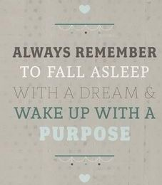
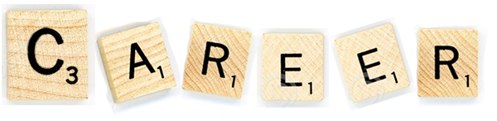
But Do I Really Need to Think about it?
But why do I need to worry about it today I have enough time to prepare ?
I know it all!
I am “Perfect” !
My CGPA is good, I would get the job.
I have my Dad’s business, I don’t need to worry.
LOVELY PROFESSIONAL UNIVERSITY - DEPARTMENT OF SOFT SKILLS

Slide 4

The Irony…
India produces approx. (annually)
27.3 million* University graduates
1,500,000(15 lakhs)*Engineers
Still…
30% University graduates
48% of Engineers are unemployed
*Acc to https://www.newindianexpress.com/nation/2022/jan/21/higher-education-stagnated-in-india-48-engineers-unemployed-niti-aayog-v-c-2409403.html#:~:text=T20%20World%20Cup-,Higher%20education%20stagnated%20in%20India%2C%2048,engineers%20unemployed%3A%20NITI%20Aayog%20V%2DC
LOVELY PROFESSIONAL UNIVERSITY - DEPARTMENT OF SOFT SKILLS

Slide 5
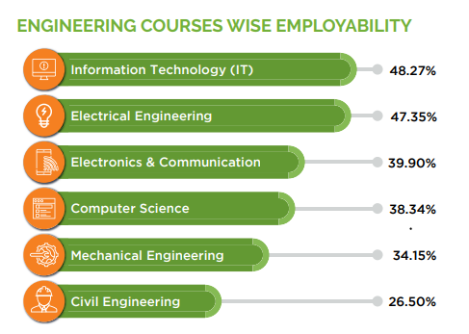
MOMENT OF TRUTH…
LOVELY PROFESSIONAL UNIVERSITY - DEPARTMENT OF SOFT SKILLS

Slide 6
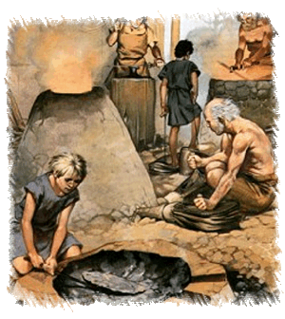

The change..
Earlier
Employers looked for thorough knowledge and understanding in their employees
Today
Companies expect certain skills in their staff to back the knowledge
What are those Skills?
LOVELY PROFESSIONAL UNIVERSITY - DEPARTMENT OF SOFT SKILLS

Slide 7
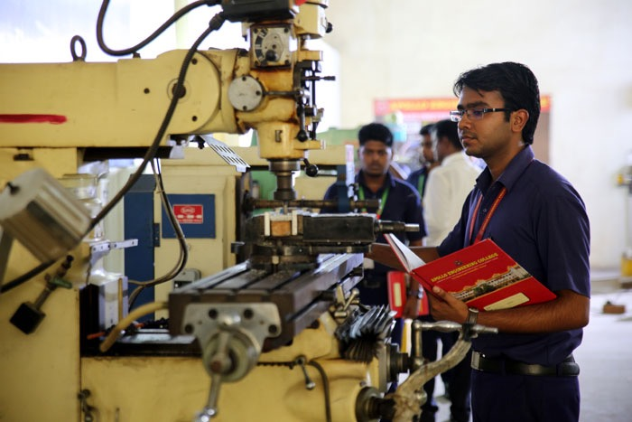
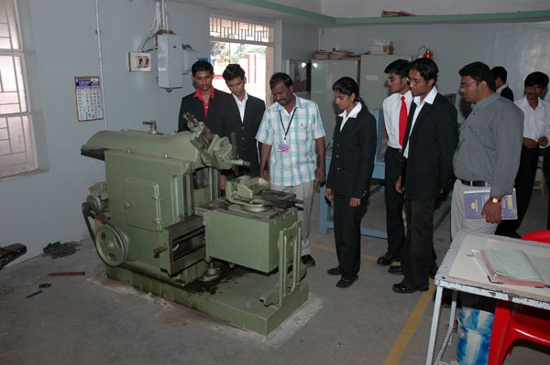
For getting Employed, what is more important?
Hard Skills
or
Soft Skills
LOVELY PROFESSIONAL UNIVERSITY - DEPARTMENT OF SOFT SKILLS

Slide 8
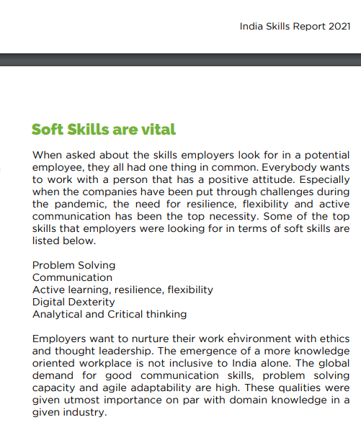

INDIA SKILLS REPORT 2021

Slide 9
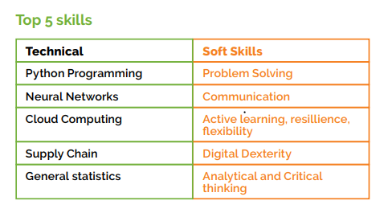
And the expert says….
Alyssa Merwin, vice president of LinkedIn Sales Solutions says that as more and more sales professionals work primarily online without traditional face-to-face meetings, they will need even stronger listening and empathy skills.
“Active listening, problem-solving, critical thinking and relationship-building are the top skills and attributes required for performing sales professionals today,” says Merwin.
Vivek Ravisankar, CEO of Hacker Rank, a technical recruiting platform, agrees that soft skills will become more important in the years ahead.
LOVELY PROFESSIONAL UNIVERSITY - DEPARTMENT OF SOFT SKILLS

Slide 10
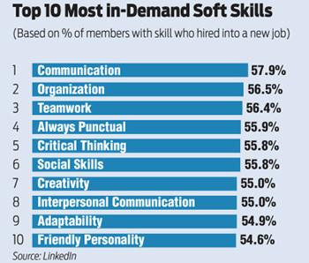
LOVELY PROFESSIONAL UNIVERSITY - DEPARTMENT OF SOFT SKILLS

Slide 11
Soft Skills… Why me?
Meaningful employment
Competitive advantage in today’s economy
“Technical Skills will get you the interview, but it’s the soft skills that get you the job”
LOVELY PROFESSIONAL UNIVERSITY - DEPARTMENT OF SOFT SKILLS

Slide 12

Soft Skills?
Connecting classrooms to Career….
LOVELY PROFESSIONAL UNIVERSITY - DEPARTMENT OF SOFT SKILLS

Slide 13
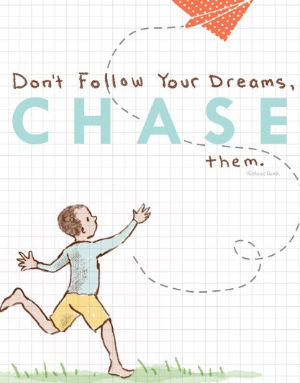
How are these classes different?
Student Centric Training
Interaction … Rule of 70:30
Imbibing Professionalism
Effective Body Language
Activities -Simulating Real Life Situation
Applying knowledge through Collaborative Learning
Use of Audio-Visual aids
Building confidence in Communication
Generating quest for Reading and Knowledge
LOVELY PROFESSIONAL UNIVERSITY - DEPARTMENT OF SOFT SKILLS

Slide 14
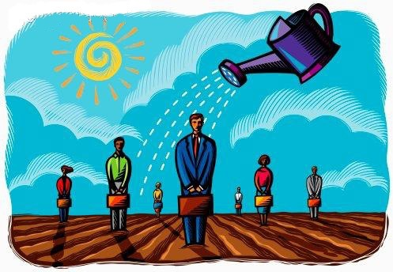
Our Expectations…
Dressing professionally for the classes
Wearing ID cards
Communication in English
Active participation in
Class activities
Club activities
Events
Reading newspaper
LOVELY PROFESSIONAL UNIVERSITY - DEPARTMENT OF SOFT SKILLS

Slide 15


Learning through Doing…
So are we ready??
LOVELY PROFESSIONAL UNIVERSITY - DEPARTMENT OF SOFT SKILLS

Slide 16
Overall Assessment
LTP- 1-2-0
Credits-3
Total- 100 marks
Academic task- 4(compulsory)
Academic Tasks- 30 marks each
No mid term examination
Attendance - 15 marks
End Term Practical- 55 Marks
Notes:
All AT’s are equally impoortant

Slide 17
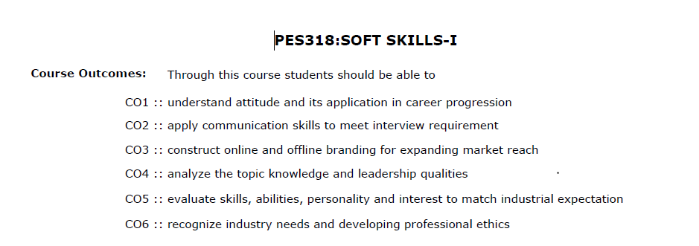
COURSE OUTCOMES PES 318

Slide 18
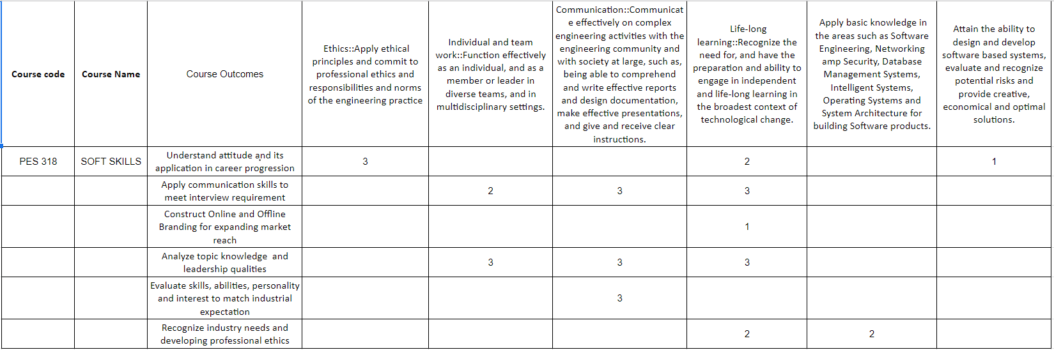
MAPPING OF CO WITH PO

Slide 19
Continuous Assessment (CA)
CA1 – Presentation Individual 1 –SWOT Presentation
CA2 – Presentation Individual 2 – Elevator Pitch
CA3 – Group Discussion
CA4 - Interview

Slide 20
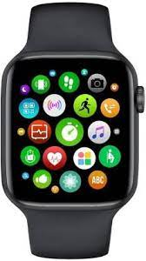
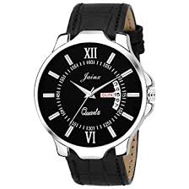
What makes a difference?

Slide 21
PES 318
Unit I Attitude Building : introduction to attitude, difference between attitude and behaviour, why is attitude important in an interview? personality traits an engineer should have, matching profession to your personality, introduction to different career pathways and swot analysis.
Unit II Building Communication Skills : oral communication and its importance in interview, active listening, engaging speaking skills, barriers to communication, non-verbal communication and its importance in interview, using paraverbal communication, introduction to virtual communication techniques.
Unit III Personal and Social Branding : introduction to self-branding, resume building, introduction to video CV and profiles, creating an impressive elevator pitch using USP's, introduction to various platforms of branding- LinkedIn, GitHub, using social media platforms constructively for branding.

Slide 22
PES 318
Unit IV Group Discussion : introduction to group discussions, idea generation techniques- SPELT, KWA, 5W 1H, brainstorming, POPBEANS, VAP, types of group discussion topics, picking the right strategy, do’s and don’ts of group discussion, types of group discussion.
Unit V Interview Skills : interview preparation, pre-interview preparation, interview kit, power dressing, know your company, interview etiquette in online and offline scenarios, types of interviews, answering techniques.
Unit VI Workplace Etiquette : introduction to professional ethics, teamwork, leadership, email etiquette, empathy and decision- making

Slide 23
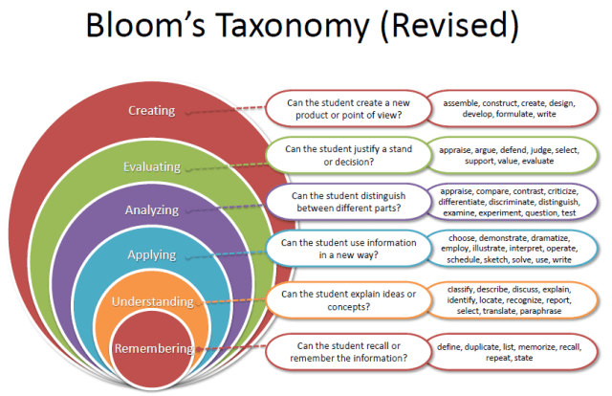
Revised Bloom’s Taxonomy

Slide 24
Unit 1- Attitude Building

Slide 25
What is an attitude and behavior ?
BASIS FOR COMPARISON | ATTITUDE | BEHAVIOR
Meaning | Attitude refers to a person's mental view, regarding the way he/she thinks or feels about someone or something. | Behaviour implies the actions, moves, conduct or functions of an individual or group towards other persons.
Based on | Experience and observation | Situation
Trait | Human | Inborn
What is it? | A person's mindset. | Outward expression of attitude.
Reflects | What you think or feel? | What you do?
Defined by | Way we perceive things. | Social Norms

Slide 26
Let’s Understand Roles of Soft Skills
What makes you confident?
What makes you to gel up with strangers?
How do you come to a decision?
What creates an impact on others?
How do you start a task and finish it?

Slide 27
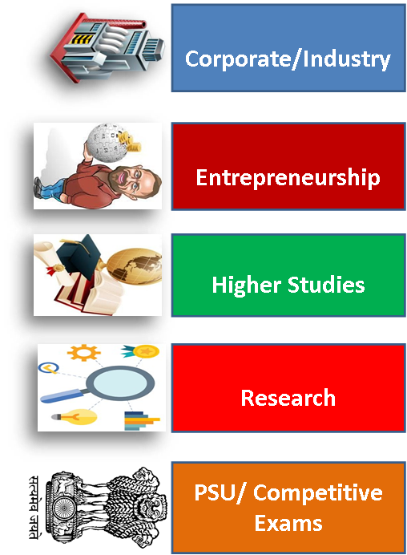
Career Pathways

Slide 28
SWOT
Strengths: Internal characteristics of a person give it an advantage over others.
Weaknesses: Internal characteristics of the person at a disadvantage relative to others.
Opportunities: Platforms/ elements in the environment that could exploit to its advantage.
Threats: Elements that can create trouble or issues.

Slide 29
Impact during the interviews
• Observe body language
• Assess communication skills(Like Articulation of content, Interpersonal skills during coding )
• Check for enthusiasm
• Prepare a variety of questions
• Ask behavioural questions
Critical thinking ( Like in HM round, Hiring manager round)

